Slide 1
Foxcore Retail Case Analysis
Presented By: Hetal Virendrabhai Gandhi
Akanksha Shrivastava Anandi Singh
Unnati Agrawal
Diana Nyaama Asilga
Jahnvi Kansara

Slide 2
Contents
Introduction
Problem Statement
Objective
Proposed solution
Database Design
Normalization
DDL Statements
Insert, update and delete Statements
Select Statements
Conclusion

Slide 3
Introduction
Foxcore Retail is a small retail business founded by business partners Liam Corrigan and Mitchell Fox. The company specializes in selling inexpensive novelty items at music festivals and trade shows across Ontario.
Problem Statement
Manual sales tracking
Excel use caused admin burden
Data errors, and redundancy
Commission calculations were inefficient, insights limited, and inventory estimates inaccurate.
Need for a robust database system.

Slide 4
Challenges
Legacy System Inefficiencies: Foxcore had manual, paper-based sales tracking processes, resulting in administrative headaches and high incidences of data inaccuracy.
Commission Complexity: Inefficiencies were most evident in the calculation of sales commissions, resulting in delays and errors.
Inability to Gain Strategic Insights: The absence of real-time information made it difficult to derive actionable insights or offer strategic decision support.

Slide 5
Objective
Eliminates redundancy and data inconsistency.
To get a real time track of the product sales, employee commissions, and event performance.
Enhances planning and operational decision-making.
Facilitates performance monitoring across products, sales consultants, and event venues.
Consolidated and centralized Business data.
Improve inventory management.
Streamline administrative processes.
Support scalability.
Proposed Solution
To implement a centralized, reliable and scalable database system to manage volume of business information.

Slide 6
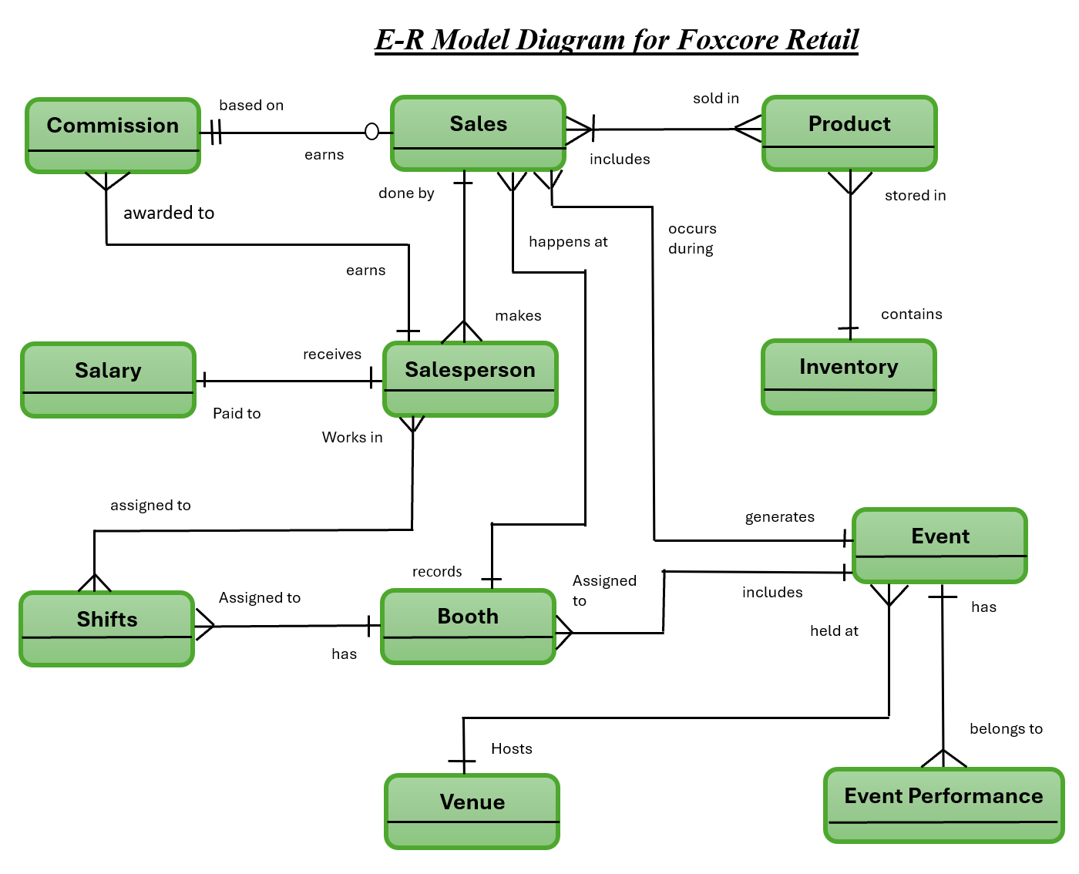
Entity-Relation Diagram:

Slide 7
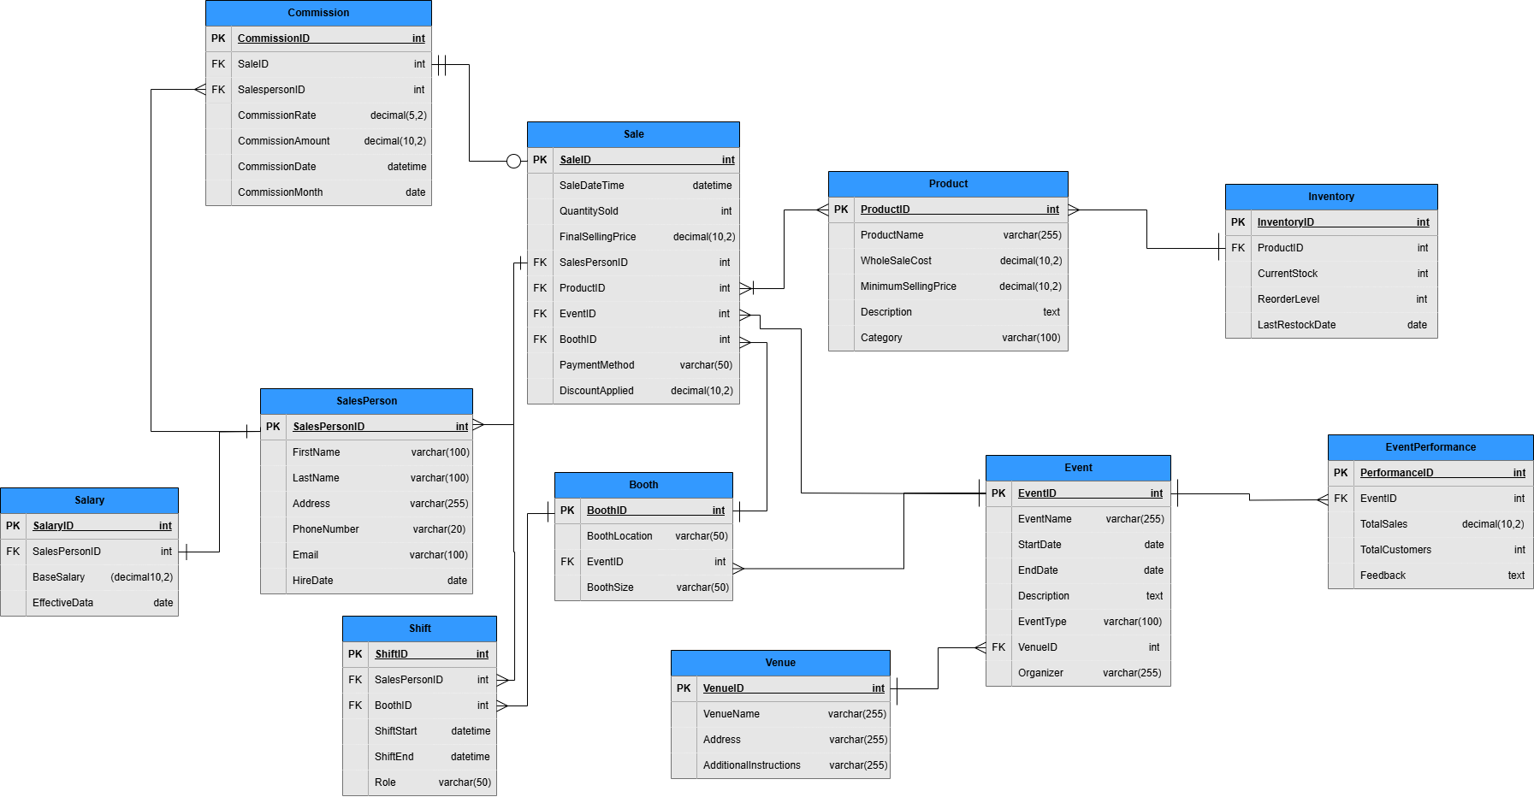
Relational Database Schema:

Slide 8
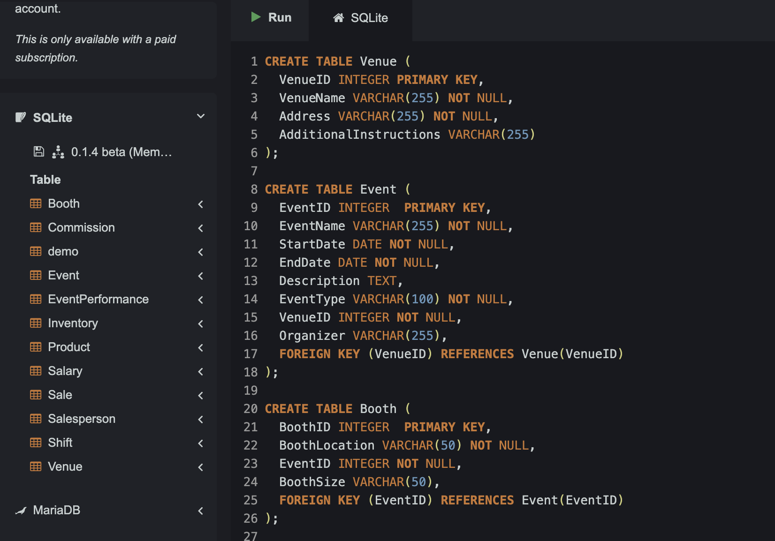
DDl Statements - Create Commands:

Slide 9
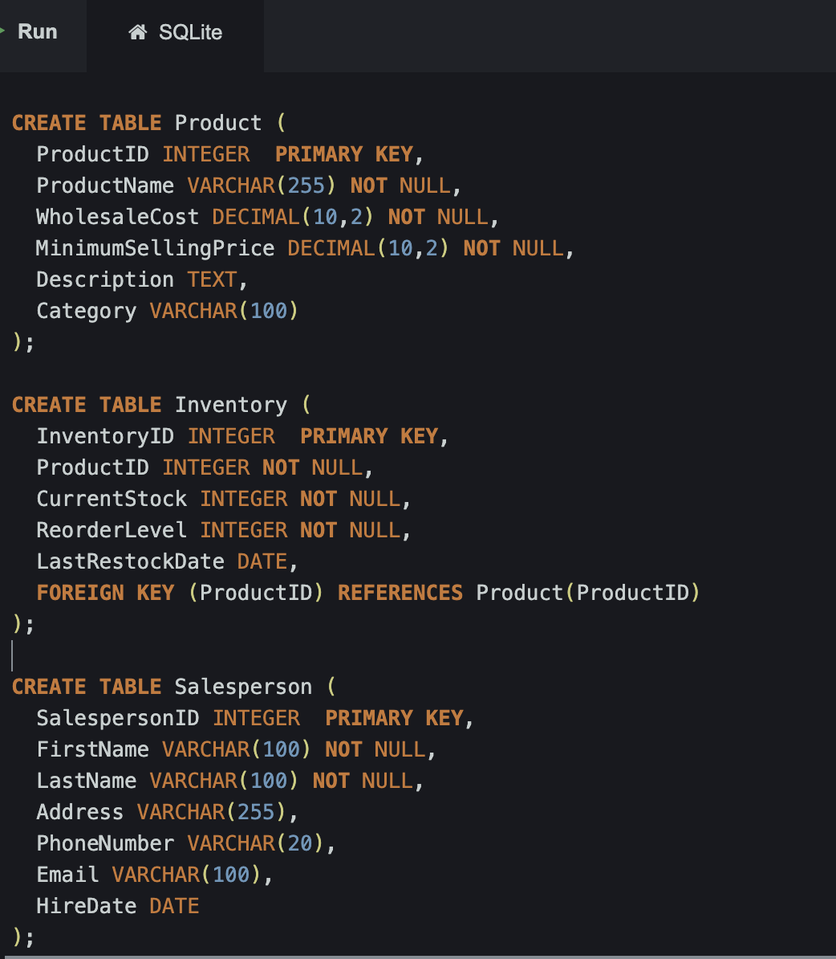
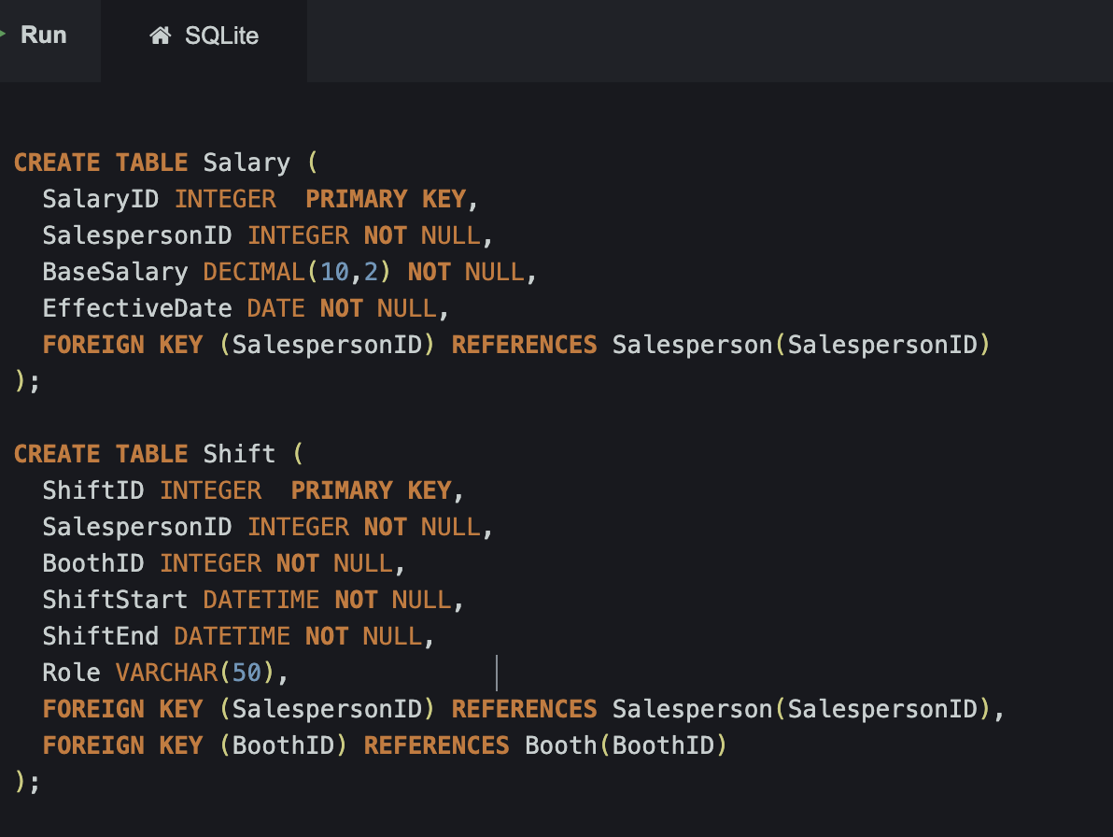

Slide 10
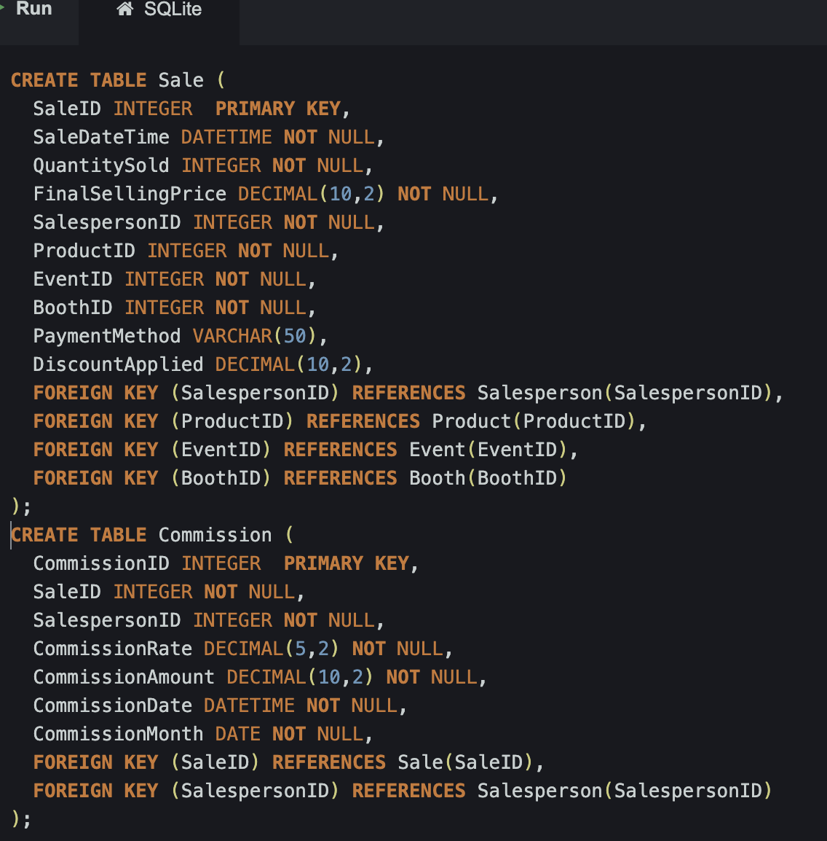
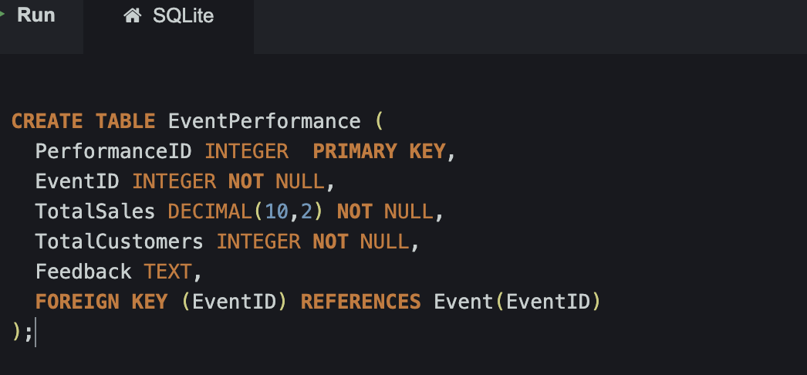

Slide 11
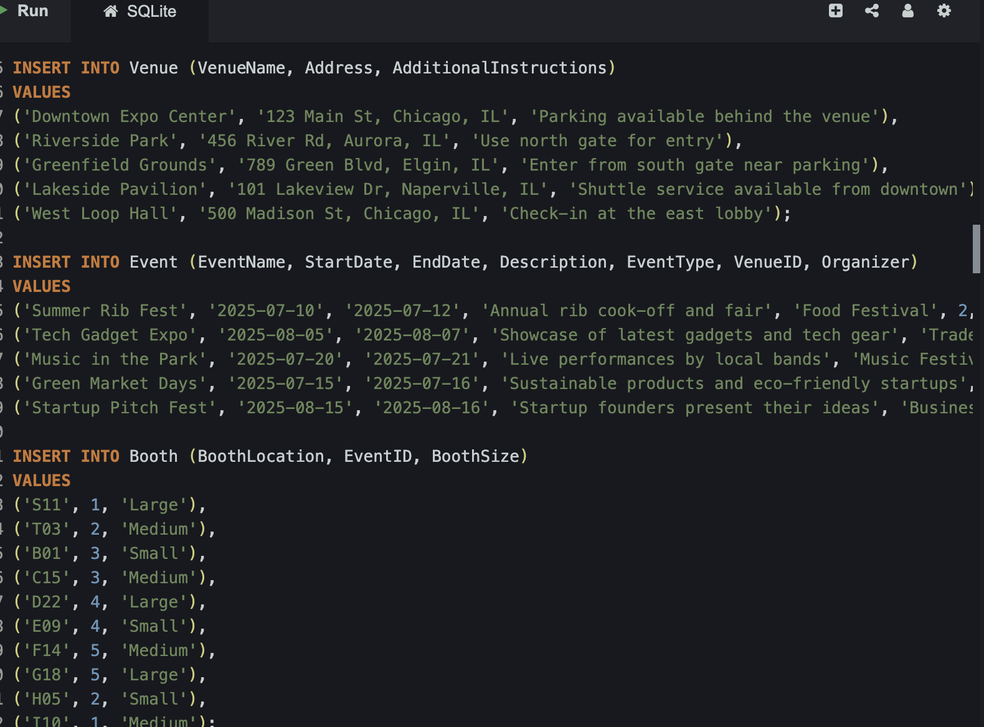
Insert Statements:

Slide 12
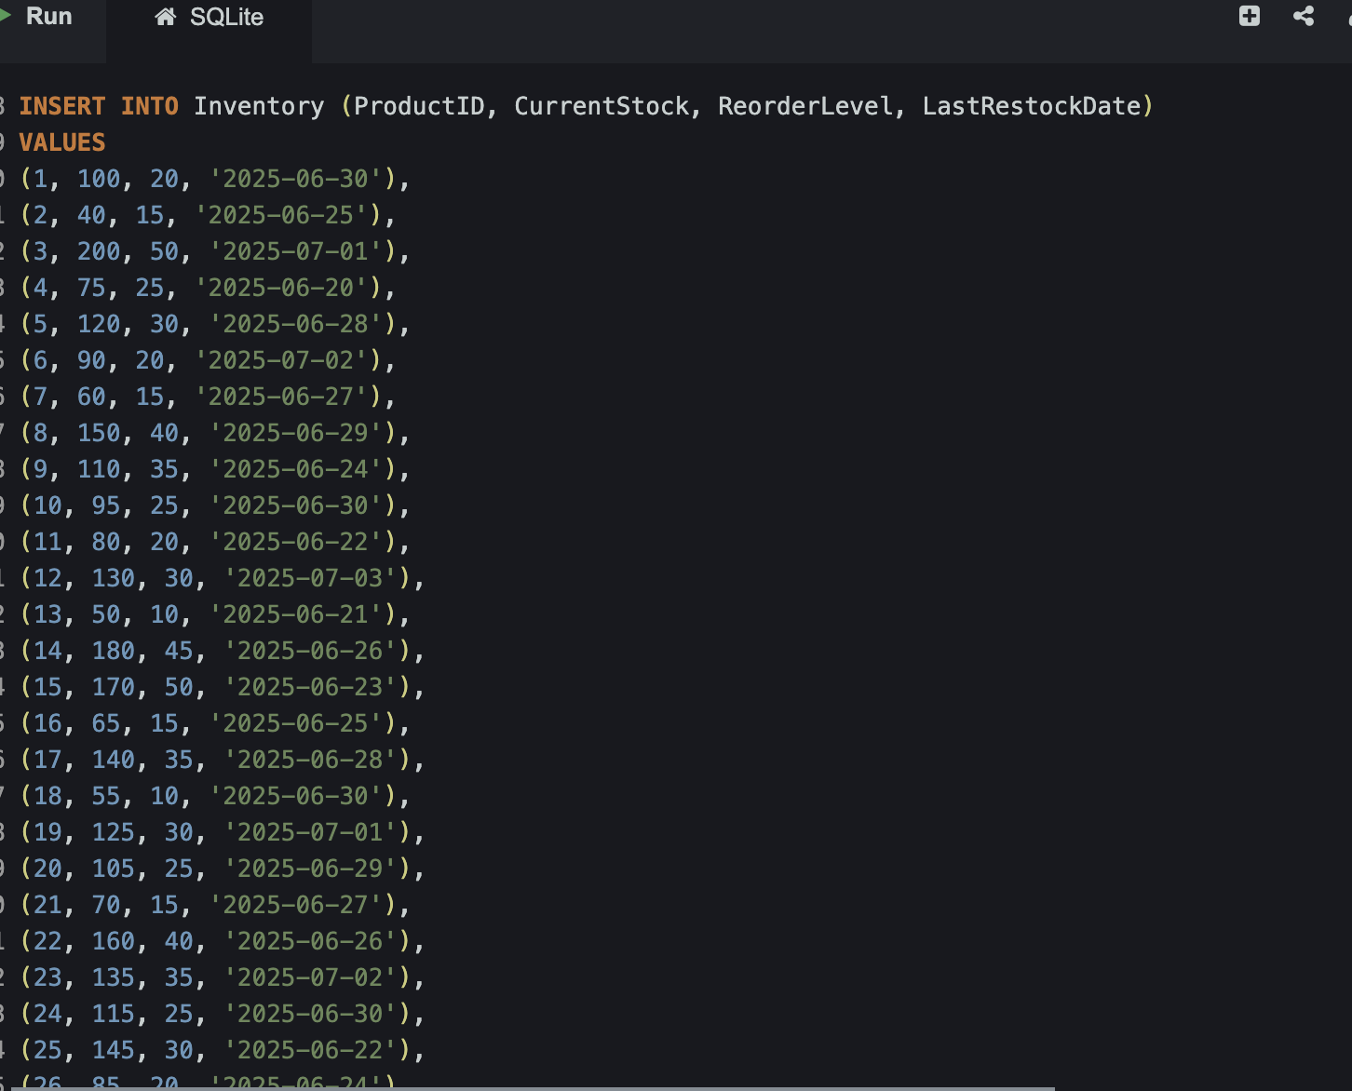
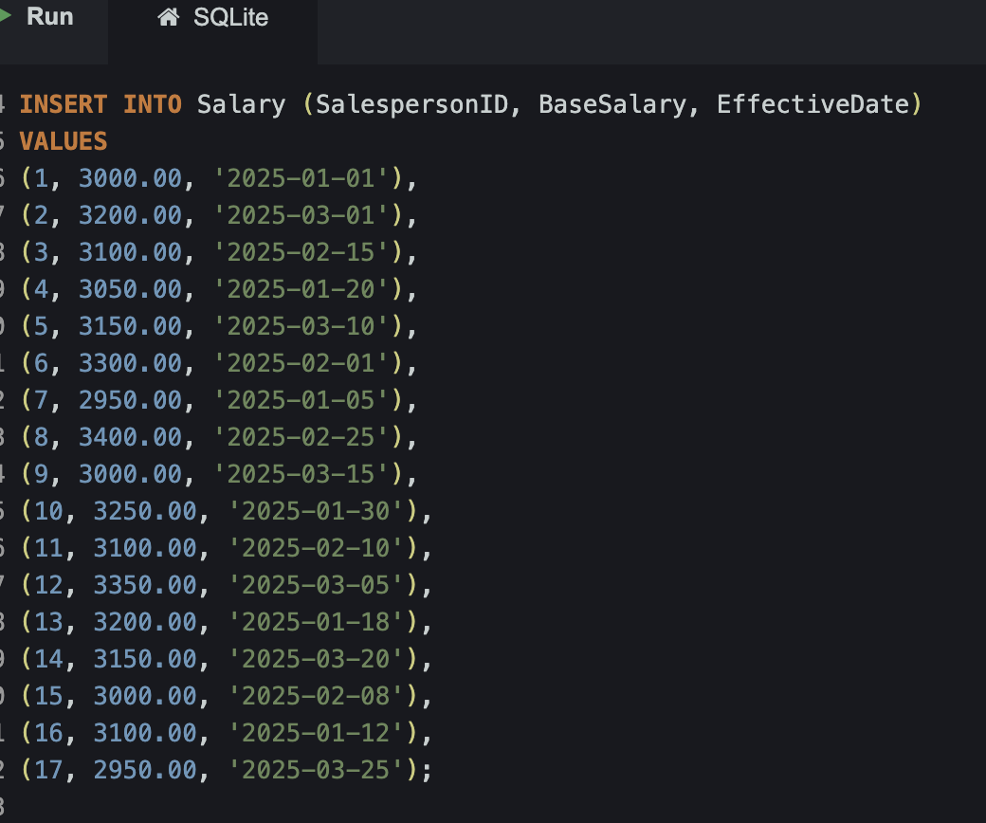

Slide 13
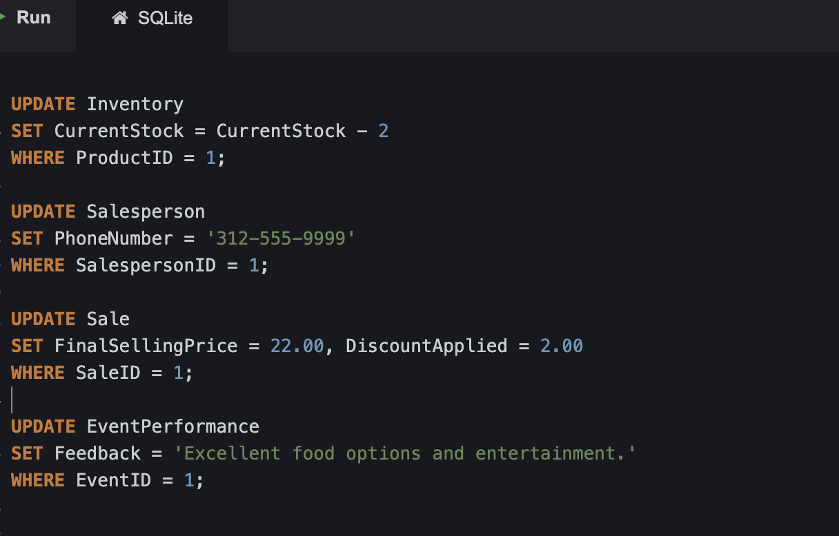
Update Statements:

Slide 14
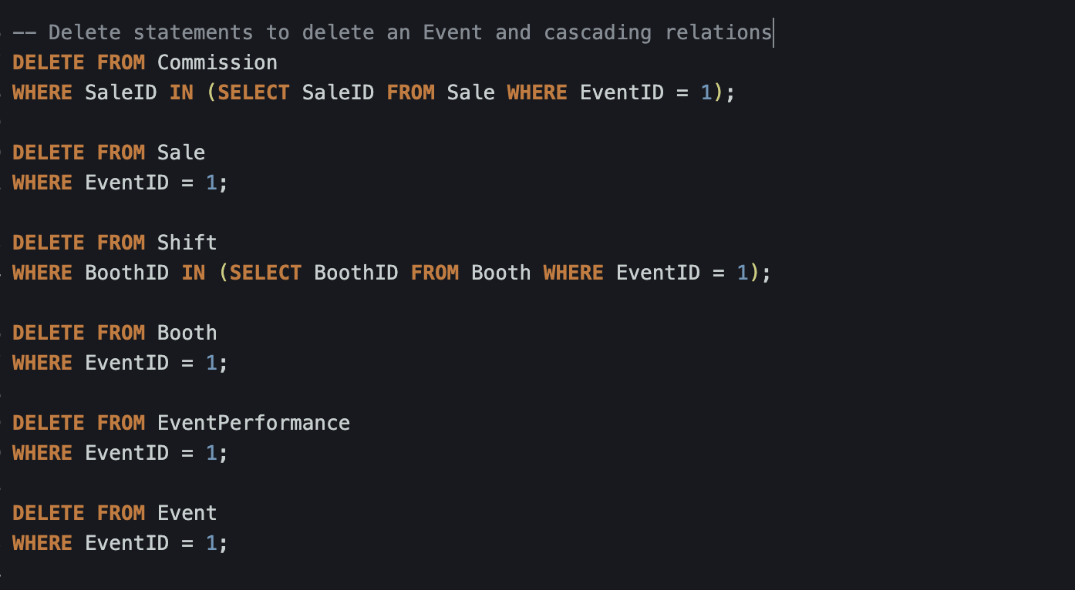
Delete Statements:

Slide 15
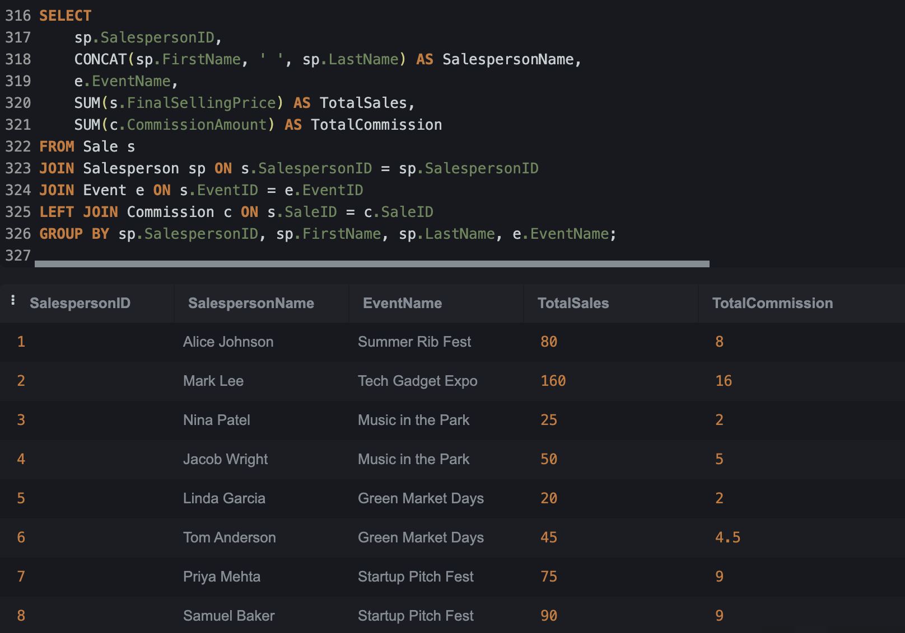
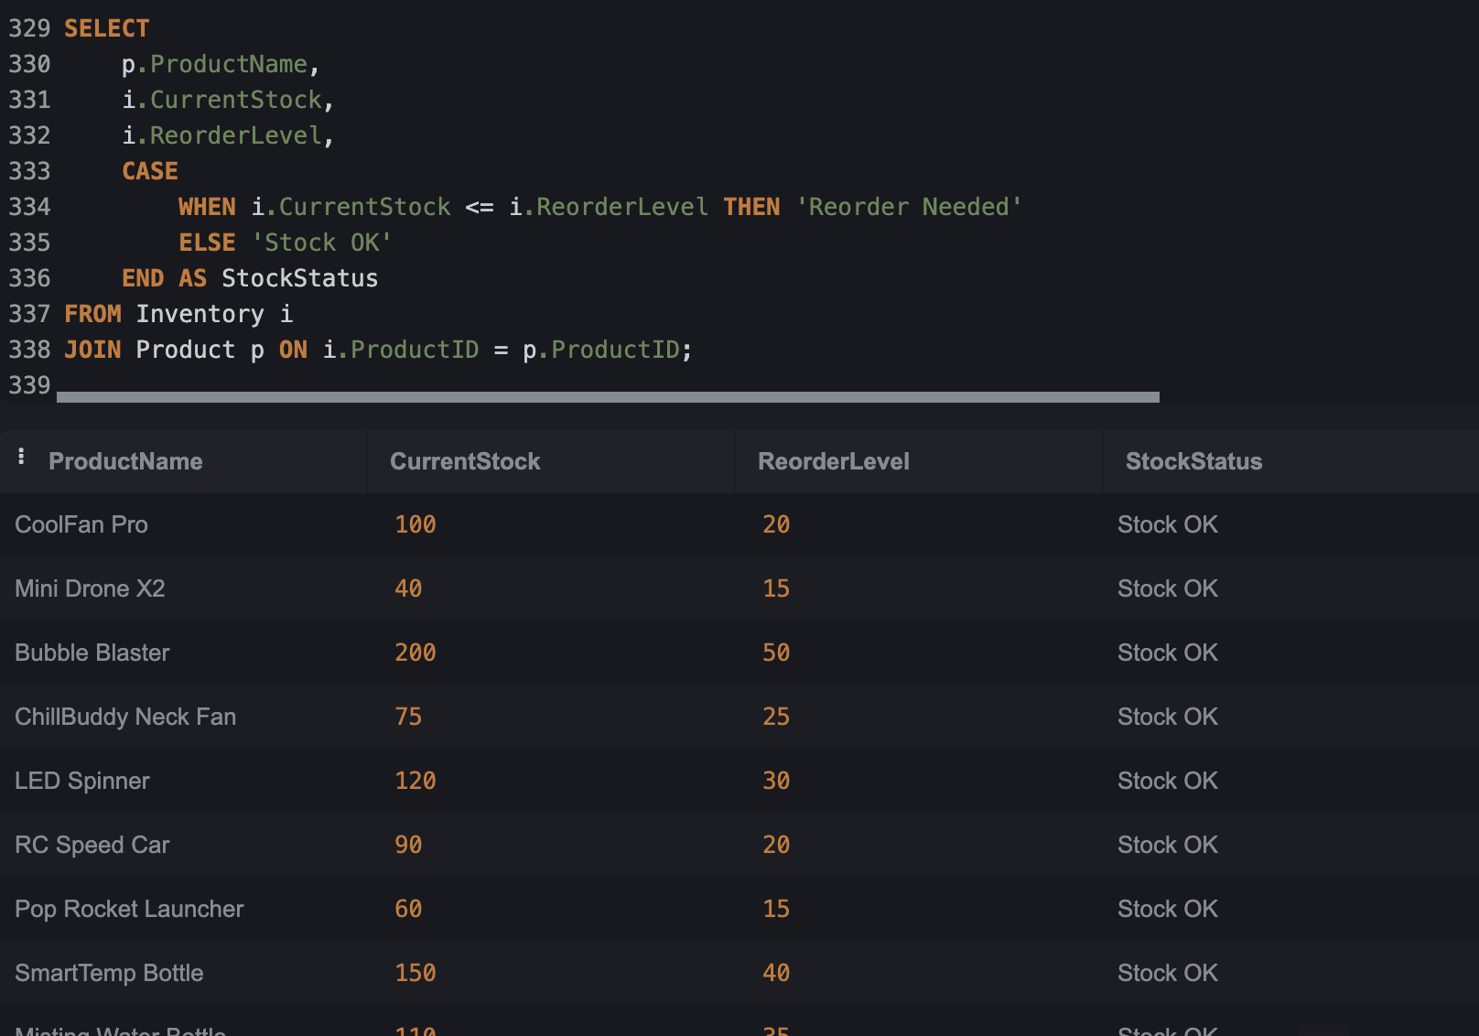
Select Statements:

Slide 16
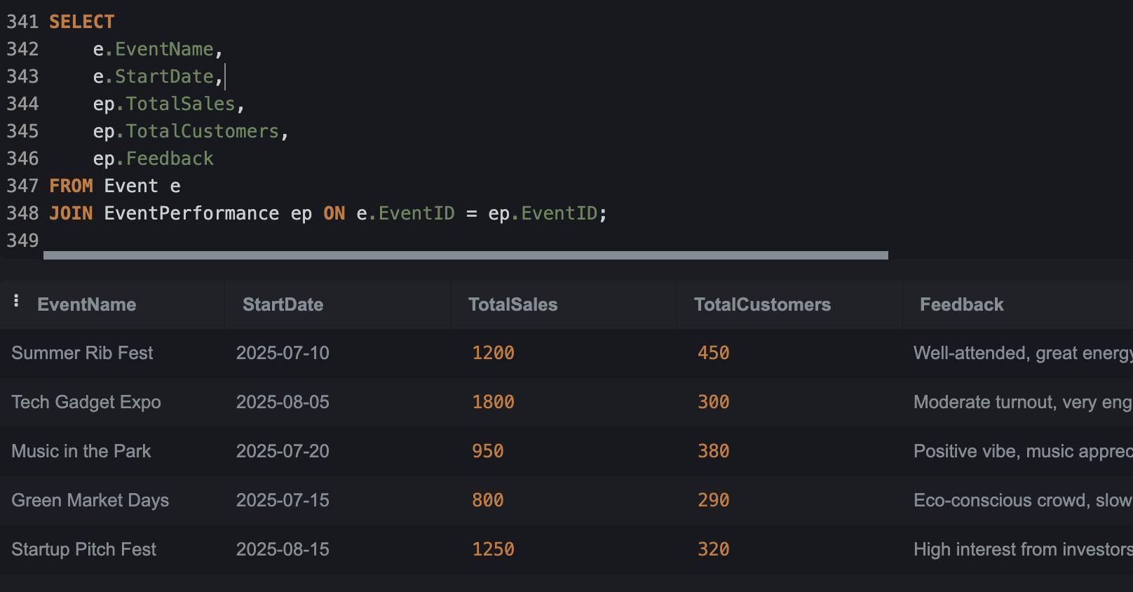
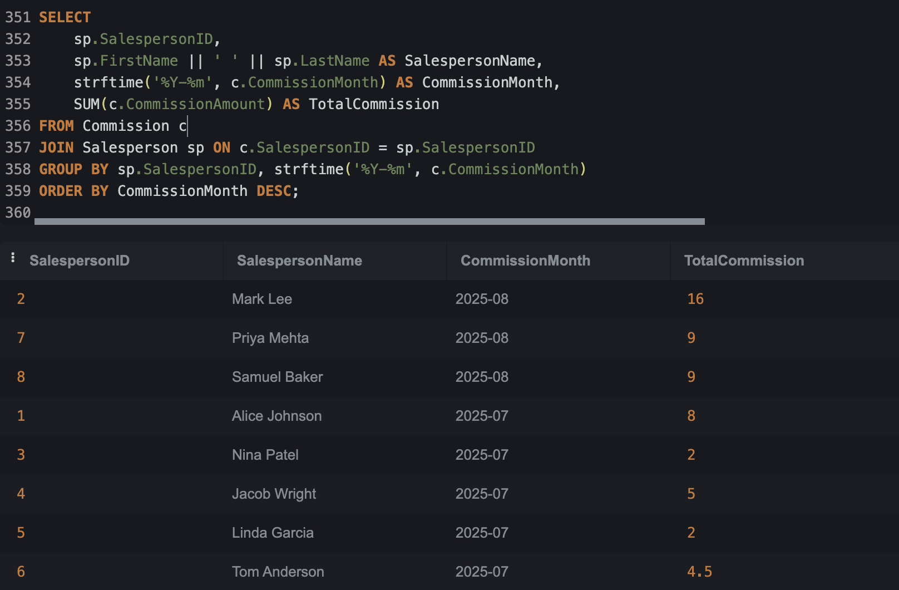

Slide 17
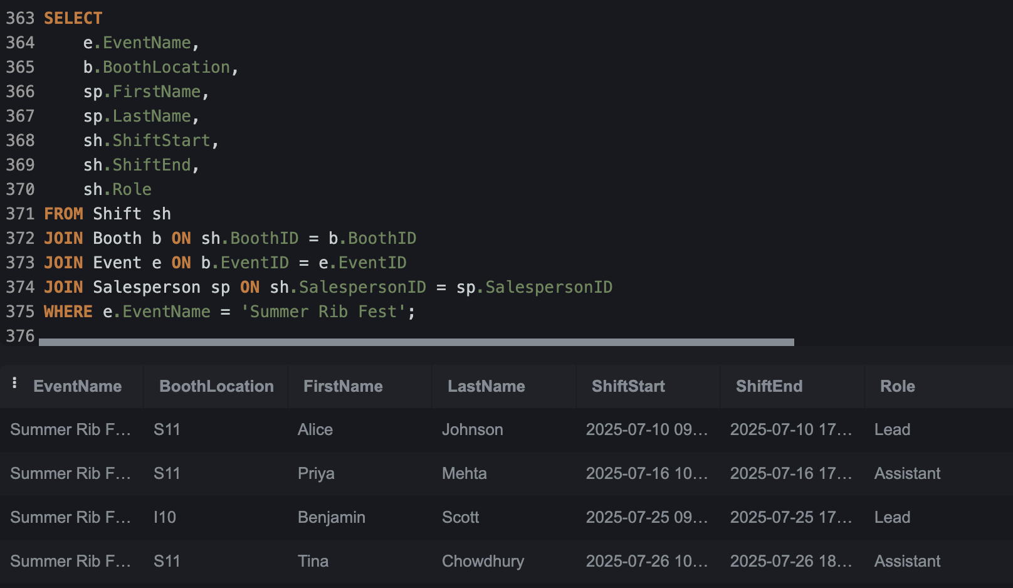
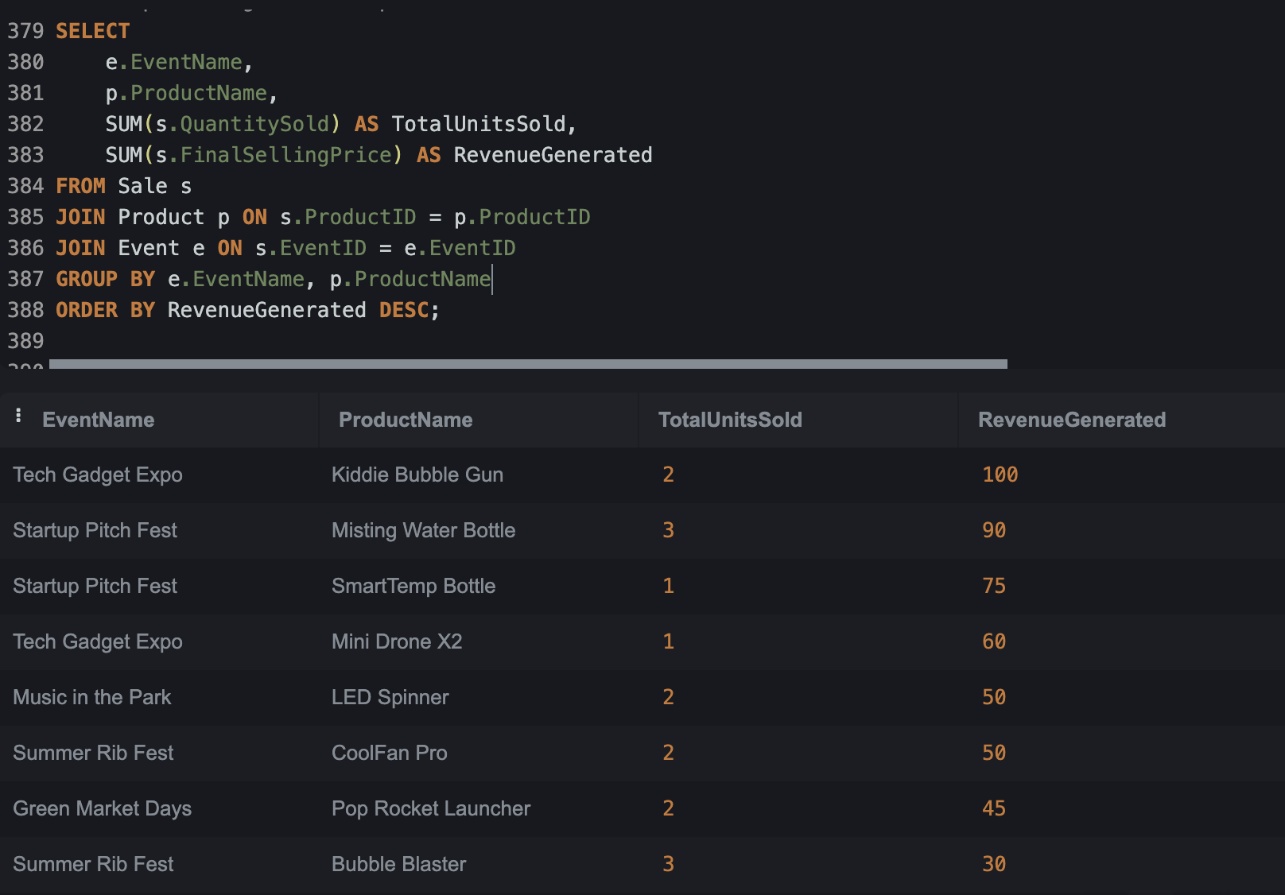

Slide 18
Conclusion

Slide 19
Automated and accurate calculation of sales commissions.
Improved tracking of sales performance by salesperson, product, and event.
Enhanced inventory management to prevent stockouts and overstocking.
Better understanding of product performance and sales trends to inform business decisions.
Streamlined administrative processes and reduced errors.
Conclusion:

Slide 20
Thank You
Q & A

